Slide 1
Introduction to Machine Learning
CCS3102

Slide 2
This Week
Introduction to Unsupervised Learning
Applications of Unsupervised Learning
KMeans Clustering
Within-Cluster Sum of Squares and Elbow plot
Evaluating Unsupervised Models
Practical Examples

Slide 3
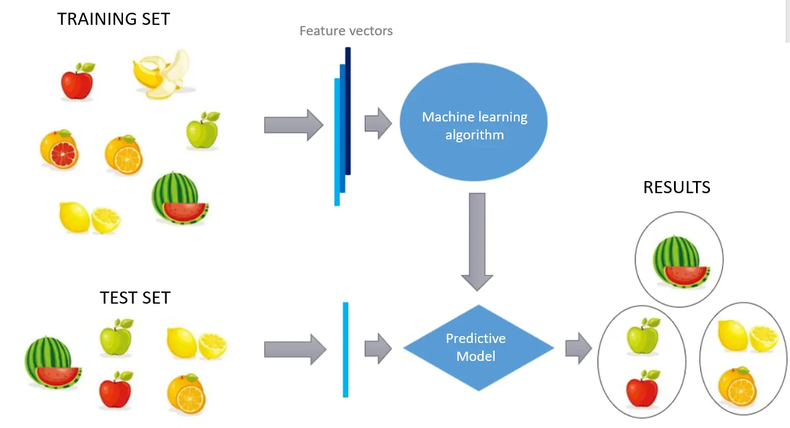
Introduction to Unsupervised Learning
What is Unsupervised Learning?
Unsupervised learning works with data that has no labels or target outputs. Unlike supervised learning where you have input-output pairs, here you only have inputs and must discover hidden patterns or structures within the data itself.

Slide 4
Introduction to Unsupervised Learning
Core Intuition
Think of it like being a detective examining clues without knowing what crime was committed. You're looking for patterns, groupings, or anomalies in the data without being told what to look for specifically.

Slide 5
Applications of Unsupervised Learning
What are the categories or applications of Unsupervised Learning?
Clustering finds natural groupings in data.
For example, segmenting customers based on purchasing behavior without knowing beforehand how many segments exist or what defines each segment.
Dimensionality reduction simplifies complex data while preserving important information.
Imagine trying to visualize data with 100 features on a 2D plot - techniques like PCA help you find the most important dimensions.
Association rule learning discovers relationships between different variables.
like "people who buy bread also tend to buy butter."
Anomaly detection identifies unusual patterns that don't fit the norm
useful for fraud detection or quality control.

Slide 6
Applications of Unsupervised Learning
Real-World Applications
Market research uses clustering to identify customer segments. Recommendation systems use collaborative filtering to suggest products. Data visualization relies on dimensionality reduction to make complex datasets understandable. Gene sequencing uses clustering to identify related genetic patterns.
Key Challenges
Evaluation is tricky since there's no "correct answer" to compare against. Results can be subjective and require domain expertise to interpret. Different algorithms may produce very different results on the same data.
Common Algorithms to Cover
K-means clustering, hierarchical clustering, Principal Component Analysis (PCA), and DBSCAN provide good foundational coverage of the main techniques.

Slide 7
KMeans Clustering
Intuition
Imagine you're organizing a school dance and need to set up k tables. You want to group people so that friends sit together and minimize the total distance people have to walk from their seats to socialize. K-means does exactly this - it finds k "table locations" (centroids) that minimize the total distance from all people to their assigned tables.

Slide 8
KMeans Clustering
Algorithm
Choose the number of clusters (k) - Decide how many groups you want to create in your data.
Initialize centroids - Randomly place k points in the data space as initial cluster centers.
Assign data points to clusters - Calculate the distance from each data point to all centroids and assign each point to the nearest centroid.
Update centroids - Move each centroid to the average position of all points assigned to that cluster.
Check for convergence - Determine if the centroids have stopped moving significantly or if maximum iterations are reached.
Repeat assignment and update steps - Continue alternating between assigning points and updating centroids until convergence.
Output final results - Return the cluster assignments for all data points and final centroid positions.

Slide 9
KMeans Clustering
Choose the Number of Clusters (k)
Elbow Method
Plot the within-cluster sum of squares (WCSS/inertia) against different values of k. Look for the "elbow" point where the rate of decrease sharply changes.
Silhouette Analysis
Calculate the silhouette score for different values of k and choose the k that maximizes this score. The silhouette score measures how similar each point is to its own cluster compared to other clusters. Higher silhouette scores indicate better-defined clusters.
Gap Statistic
Compare the within-cluster dispersion of your data with that of a reference null distribution (random data). The optimal k is where the gap between your data and random data is largest. This method is more statistically rigorous but computationally intensive.
Domain Knowledge
Use subject matter expertise to determine meaningful numbers of clusters. For customer segmentation, you might know from business experience that 3-5 segments work best for marketing campaigns. For gene analysis, biological knowledge might suggest expected groupings.

Slide 10
KMeans Clustering
Choose the Number of Clusters (k) - Practical Consideration and Pitfalls
Practical Considerations
Try multiple methods and see if they agree on a similar k value. Consider the interpretability and actionability of the results - sometimes a slightly suboptimal k is better if it produces more meaningful clusters. Remember that there's often no single "correct" answer, and the best k depends on your specific use case and objectives.
Common Pitfalls
Avoid choosing k based solely on mathematical optimization without considering domain relevance. Don't assume the elbow will always be clearly visible - sometimes the curve is smooth. Consider that different initialization methods might suggest different optimal k values.

Slide 11
KMeans Clustering
Initialize Centroids
Random Initialization
Place k centroids at random locations within the data space. This is simple but can lead to poor clustering results and slow convergence. The algorithm might get stuck in local optima, especially with unlucky initial placements.
Random Selection from Data Points
Randomly select k existing data points as initial centroids. This ensures centroids start in regions where data actually exists, which often leads to better convergence than purely random placement.
K-means++ (Recommended)
This is the most widely used and effective method. Choose the first centroid randomly from the data points. For each subsequent centroid, select points with probability proportional to their squared distance from the nearest already-chosen centroid [P(point) = (distance to nearest centroid)² / (sum of all squared distances)]. This spreads out initial centroids and typically leads to better final clustering and faster convergence.
Furthest First
Start with a random point, then iteratively choose the point that is furthest from all previously selected centroids. This maximizes the initial separation between centroids but can be sensitive to outliers.
Multiple Random Runs
Run K-means multiple times with different random initializations and select the result with the lowest within-cluster sum of squares. Most implementations do this automatically (e.g., scikit-learn runs 10 times by default).

Slide 12
KMeans Clustering
Initialize Centroids
Why Initialization Matters
Poor initialization can lead to suboptimal clustering, longer convergence times, and empty clusters. Good initialization reduces the number of iterations needed and improves the chances of finding the global optimum rather than getting trapped in local optima.
Best Practice
Use K-means++ initialization as the default choice, as it's theoretically sound and empirically performs well across different datasets.

Slide 13
KMeans Clustering
Check for convergence
What is Convergence?
Convergence occurs when the algorithm has reached a stable state where further iterations won't significantly improve the clustering. This happens when centroids stop moving or move very little between iterations.
Common Convergence Criteria
Centroid Movement Threshold
Calculate how much each centroid moved from the previous iteration. If the total movement (sum of distances moved by all centroids) is below a small threshold (e.g., 0.001), declare convergence. This is the most common approach.
No Change in Assignments
If no data points change their cluster assignments between iterations, the algorithm has converged. This is a stricter condition than centroid movement.
Maximum Iterations Reached
Set a maximum number of iterations (e.g., 300) to prevent infinite loops. If this limit is reached, stop even if other convergence criteria aren't met.
Relative Change in Objective Function
Monitor the within-cluster sum of squares (WCSS). If the improvement between iterations falls below a threshold (e.g., 0.01%), consider it converged.

Slide 14
KMeans Clustering
How this clustering works when there are multiple features
Distance Calculation in Multiple Dimensions
Instead of calculating distance in 2D space, K-means uses Euclidean distance across all features. For a data point with features [x₁, x₂, x₃, ..., xₙ] and centroid [c₁, c₂, c₃, ..., cₙ], the distance is: √[(x₁-c₁)² + (x₂-c₂)² + (x₃-c₃)² + ... + (xₙ-cₙ)²]
Centroid Calculation
Centroids are calculated as the mean across all dimensions. For each cluster, the centroid becomes [mean(x₁), mean(x₂), mean(x₃), ..., mean(xₙ)] of all points assigned to that cluster.

Slide 15
KMeans Clustering
Considerations
Feature Scaling Becomes Critical
Different features often have different scales (age in years vs income in dollars vs number of purchases). Features with larger scales will dominate the distance calculation. Always standardize or normalize features before clustering so each feature contributes equally to the distance calculation.
The Curse of Dimensionality
As the number of features increases, several challenges emerge. All points tend to become equidistant from each other in high-dimensional space, making clustering less meaningful. The volume of the space increases exponentially, making data points sparser. Distance-based measures become less discriminative.
Use PCA or other dimensionality reductions to dimensionality.
Use other feature selection strategies.

Slide 16

Within-Cluster Sum of Squares and Elbow plot
Within-Cluster Sum of Squares (WCSS)
What it measures:
WCSS calculates how tightly packed your clusters are. It's the sum of squared distances from each data point to its cluster center (centroid).
Mathematical formula:
For each cluster, take every point, measure its distance to the cluster center, square that distance, then add up all these squared distances across all clusters.
Distance (x_{j}^{(i)}, c_{i}) represents the distance between j-th data point from its centroid c_{i} of that cluster.
What the numbers mean:
Lower WCSS = points are closer to their cluster centers = tighter, more cohesive clusters
Higher WCSS = points are farther from their cluster centers = looser, more spread out clusters
Simple analogy:
Think of WCSS like measuring how close family members sit to each other at different tables during a family reunion. Lower WCSS means families are sitting closer together at their respective tables.

Slide 17
Within-Cluster Sum of Squares and Elbow plot
The Elbow Plot
What it shows:
A graph with number of clusters (k) on the x-axis and WCSS on the y-axis. As k increases, WCSS always decreases.
Why WCSS always decreases:
With k=1: All points go to one cluster center - usually high WCSS
With k=2: Points split between two centers - lower WCSS
With k=3: Points split between three centers - even lower WCSS
With k=n (where n = number of data points): Each point is its own cluster center - WCSS = 0
The "elbow" shape:
The plot typically shows a steep decline initially, then levels off. The curve resembles a bent arm, with the "elbow" being the point where the rate of improvement slows down dramatically.
How to find the optimal k:
Look for the elbow point - where adding more clusters doesn't give you much improvement in WCSS. This represents the best trade-off between having fewer clusters (simplicity) and having tight clusters (good fit).

Slide 18
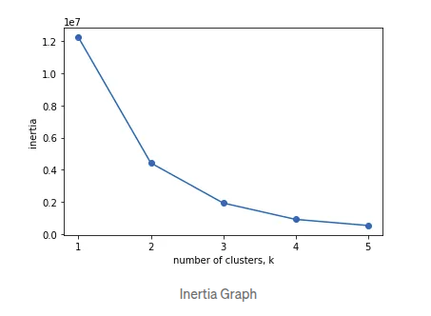
Within-Cluster Sum of Squares and Elbow plot
The Elbow Plot

Slide 19
Evaluating Unsupervised Models
Evaluating unsupervised models is one of the most challenging aspects since there's no ground truth to compare against. Here are the main evaluation approaches.
Internal Evaluation Metrics
These assess the quality of clusters using only the data itself. For K-means specifically, inertia/WCSS measures within-cluster compactness, though it always decreases as k increases.The silhouette score measures how similar each point is to its own cluster compared to other clusters (ranges from -1 to 1, higher is better). The Davies-Bouldin index evaluates cluster separation and compactness (lower values indicate better clustering).
Visual Inspection
Plotting clusters in 2D or 3D space helps assess whether the groupings make intuitive sense. Dimensionality reduction techniques like PCA or t-SNE can help visualize high-dimensional clusters. Heat maps and dendrograms are useful for hierarchical clustering.
Domain Expert Validation
Subject matter experts can evaluate whether discovered patterns align with domain knowledge. For customer segmentation, marketing experts might assess if the segments are actionable and meaningful.
Stability Analysis
Run the algorithm multiple times with different random initializations or slightly perturbed data. Consistent results across runs indicate more reliable clustering. Cross-validation approaches like bootstrapping can test robustness.

Slide 20
Evaluating Unsupervised Models
Stability Analysis
Run the algorithm multiple times with different random initializations or slightly perturbed data. Consistent results across runs indicate more reliable clustering. Cross-validation approaches like bootstrapping can test robustness.
Business/Task-Specific Metrics
Evaluate based on downstream performance. If clusters are used for recommendation systems, measure recommendation accuracy. For anomaly detection, use precision, recall, and F1-score if you can identify some known anomalies.

